Slide 1

EE6618: Three Dimension Video Technology
Dr. P.W.M. Tsang
eewmtsan@cityu.edu.hk
Room: G6505
Department of Electronic Engineering,
City University of Hong Kong

Slide 2
Things to learn
Human 3D perception
Classical glass based stereoscopic 3D system
Glass free 3D system
Realization of glass free 3D system
The Art of Holography
Computer Generated Hologram
Binary and phase-only Holography
Realization of binary and phase-only holograms

Slide 3
Things to expect from this course
Learn a lot about classical and modern 3D technologies
Interesting
Capable of realizing something from learnt materials
Appreciate existing 3D technologies

Slide 4
Things not to expect from this course
Lots of theories and equations
Fundamental knowledge (e.g. convolution, sampling theorem, transform, etc.)
Questions for practicing calculations

Slide 5
Teaching modes
Lecturing, mostly on one way communication
Interactive teaching emphasizing on 2 way communication (e.g. tutorial, mini-projects, test, etc.)
Both are important towards effective learning

Slide 6
Assessment and examination
Course works (60%)
Tests (2)
Mini-project on Realization of glasses free 3D system
Mini-project on Realization of binary/phase-only holograms
Demonstrations
Examination (40%)

Slide 7
Assessment
Miniprojects, and demonstrations (20%)
Mini-project on Realization of glasses free 3D system
Mini-project on Realization of binary/phase-only holograms
Demonstrations (may be replaced with reports)
Number of assignments: 3
1. Development a program with Matlab first miniproject.
2. Development a program with Matlab second miniproject.
3. Demonstration achievements in both miniprojects.
Details on date and format of assignments will be provided later

Slide 8
Assessment
2 Tests on 2 major topics (40%)
Classical 3-D system
Digital holography
Details on date and format of tests will be provided later

Slide 9
The classical 2D Photography
Film
R
L

Slide 10
The classical 2D Photography
Film
R
L
Both eyes are viewing the same picture: No 3D effect
Question: Why do we observe 3D effect?

Slide 11
Basic principles of 3D Perception
Human eyes have slightly different perception with the left and right eyes when viewing a scene image.
3D perception can be reconstructed if the image received by each eye can be recorded, and later presented to the corresponding eye.
To capture 3D scene, we need to capture what are observed by our 2, instead of a single eyes. In another words, need to capture 2 images.
L
R

Slide 12

The 3D Movie craze in the 50’s
House of Wax, starring Vincent Price and directed by André de Toth, was released by Warner’s Brother in 1953. The movie is a remake of 1933's “Mystery of the Wax Museum”.
The movie was captured in dual interlocked 35 mm film
Right camera
Scene
Left camera
The 2 cameras are simulating human eyes, capturing what will be observed by our pair of eyes

Slide 13
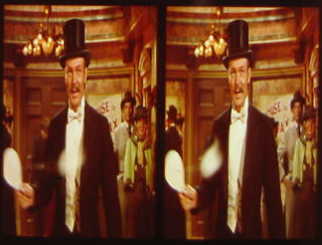
Basic principles of 3D Perception
Unfortunately, a side by side arrangement of the L and R pictures cannot direct each picture to the corresponding eye.
In this example, we simply see 2 pictures.
What would happen if the pair of images are displayed directly? See the image on the left.
While we can use 2 cameras to capture what is seen with our eyes, directly displaying them does not give the 3D effect. Why?
L
R

Slide 14
Basic principles of 3D Perception
NOT
THE
SAME
L
R
L
R
How to reproduce this from the L and the R images?

Slide 15

Practical 3D recording and viewing system
The left and right images are merged on the integrated picture, in a way that each will be diverted to the corresponding eyes.
But how?
Left
image
Right image
Integrated picture
Right projector
Left projector
Left
image
Right
image
The left and right images, are projected and overlapped on the screen, but then the viewer will see a double image instead of 3D perception
L
R

Slide 16
Practical 3D recording and viewing system
Left
image
Right image
The left and right images are merged on the integrated picture, in a way that each will be diverted to the corresponding eyes.
But how?
Integrated picture
Solution: Filtering glasses
An optical filter is a planar medium that only allows certain component of optical wave to get through, and reject the rest.
Left
image
Right
image
The left and right images are pre-processed so that they can be separated in the future with an optical filter.
L
R

Slide 17
A popular optical filter: Polarized medium
Light photons oscillates in all directions, and a polarizer only allows photons oscillating at certain angles to get through.

Slide 18
A popular optical filter: Polarized medium
Light photons polarized in certain angle can pass through a polarizer with the same angle, but will be blocked by a polarizer of a different angle
We can use this property for filtering
PASS
BLOCK

Slide 19
A popular optical filter: Polarized medium
Polarized sheet
Film
2 or more images can be combined and separated in the future, if each is polarized with a different angle.
Film
Polarized sheet
Visible only if the 2 polarizers are similar.

Slide 20
Practical 3D recording and viewing system
Left
image
Right image
Others of filters work on similar principle.
Lets have a look at an interesting photograph
0 degree
90 degree
Integrated picture
0 degree
90 degree
Left
image
Right
image
L
R

Slide 21
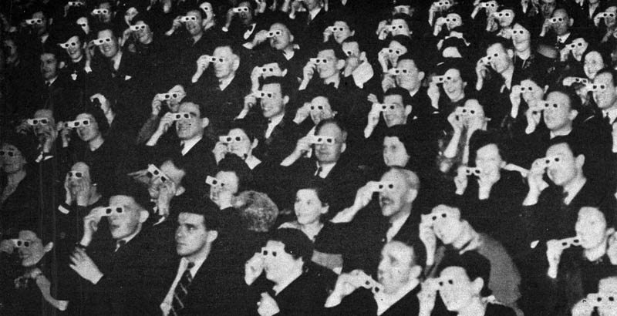

The classical 3D perception technology
Source: http://www.slidestudios.com/blog/wp-content/uploads/2009/08/3d-movie-audience.jpg

Slide 22
The 3D Movie craze in the 50’s
House of Wax, starring Vincent Price and directed by André de Toth, was released by Warner’s Brother in 1953. The movie is a remake of 1933's “Mystery of the Wax Museum”.
The movie was shown in dual interlocked 35 mm projection with polarized glasses, presented in Widescreen
A pair of images, each with a different polarization, overlap on the screen
Source of photo: from movie “Mystery of the Wax Museum”.
Noted the pair of images are shown separately to illustrate the concept. They are actually overlapped on the screen.

Slide 23
Principles of 3D Perception and Display
1. Polarized lens
Viewers have to wear a spectacles consisting of a pair of orthogonally polarized lens.
Screen
Left + Right images
Left image: 0 degree polarized
Right image: 90 degree polarized
0 degree
90 degree
L
R

Slide 24
Principles of 3D Perception and Display
2. Anaglyph images
Viewers have to wear a spectacles consisting of a pair of chromaticlly opposite (e.g. Red and Blue) lens.
Screen
Left + Right images
Left image: Red
Right image: Blue
Red
Blue
L
R

Slide 25
Principles of 3D Perception and Display
3. Shutter Glass: Time division multiplexing
Viewers have to wear a Shutter Glass spectacles that switches between left and right eye.
Screen
Right Image
L
R

Slide 26
Principles of 3D Perception and Display
3. Shutter Glass: Time division multiplexing
Viewers have to wear a Shutter Glass spectacles that switches between left and right eye.
Screen
Left Image
One shutter glasses is required for each viewers
L
R

Slide 27
Principles of 3D Perception and Display
4. Polarized screen
Viewers have to wear a spectacles consisting of a pair of orthogonally polarized lens.
Left image
Screen
Right image
0 degree polarized
90 degree polarized
Polarizer
Much cheaper than the shutter glasses. A more economical solution when there are numerous viewers.
0 degree
90 degree
L
R

Slide 28
Principles of 3D Perception and Display
5. Cordless Polarized screen
Viewers have to wear a spectacles consisting of a pair of orthogonally polarized lens. Switching of polarizer driven by content.
Screen
Left image
Optical signal
Right image
Optical Sensor
Polarization
signal
Polarizer
Multiple viewing configurations: 3D stereoscopic, Pulfrich, and normal 2D.

Slide 29
Principles of 3D Perception and Display
6. Retarder film screen
Viewers have to wear a spectacles consisting of a pair of orthogonally polarized lens.
Screen
L
R
L
R
L
R
L
R
L
R
L
R
L
R
L
R
Retarder film
Much cheaper than the shutter glasses or switched polarizer. Resolution is reduced.
0 degree
90 degree
L
R

Slide 30
Contemporary 3D display technology
Before moving on with the lecture, lets have a look at an inspiring short video clip of 3D effect in theatre.

Slide 31
Classical versus modern 3D Display
Classical stereoscopic 3D display
Monitor directs left image to left eye, and right image to right eye.
Screen
Left image
Right image
L
R

Slide 32

Current Status of 3D Display
Projection mapping: A simple but realistic holographic/3-D effect on known geometry.
Projector

Slide 33
Current Status of 3D Display
Cloaking: generating the illusion of invisibility
An opaque object will block part or whole of the scene from sight.
As such, the occluded object will become visible.
To achieve invisibility, an optical illusion is needed to generate the effect of light passing through the occluded object. this can be achieved with projection mapping, a technology that is invented in Japan at early 2000.

Slide 34
Current Status of 3D Display
Cloaking: generating the illusion of invisibility
Camera
Projector

Slide 35
Current Status of 3D Display
Aerial image projection is well known in the art for creating the illusion of a 3D image floating in space. This class of systems employs optical elements such as mirrors, and beam-splitters, etc. to project an image of an object onto a plane that is transparent to the viewers.
Half mirror
Floating image
Viewer
Virtual image
Object beam
Projector/Display

Slide 36
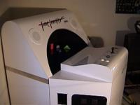
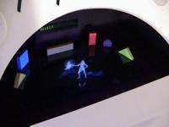
Current Status of 3D Display
Sega Time Traveler arcade game (1991)
“Time Traveler or Hologram Time Traveler is a stereographic laserdisc FMV arcade game released in 1991 by Sega and designed by Dragon's Lair creator Rick Dyer. It is called the "World's First Holographic Video Game.” www.wikipedia.com

Slide 37
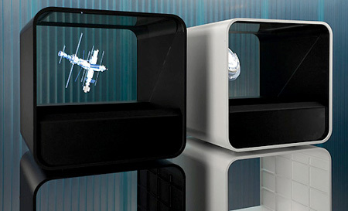
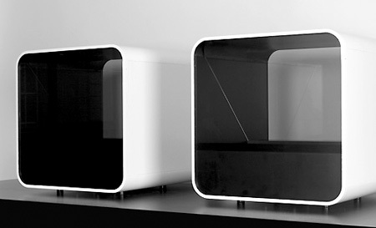
Current Status of 3D Display
The HoloCube 3D Projection Box
“Measuring about 20-inches square, the Holocube packs a 40GB hard drive for storing up to 18 hours of compressed video, which can magically float at 1080i resolution within the cube at the flick of a switch.” www.engadget.com

Slide 38
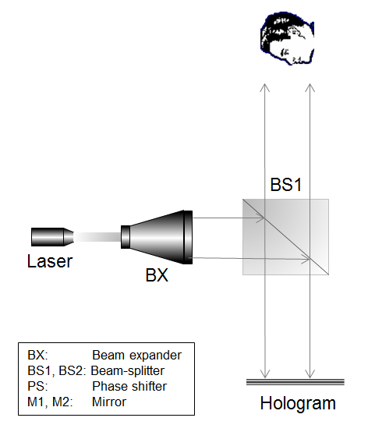
Current Status of 3D Display
Holographic aerial projector

Slide 39
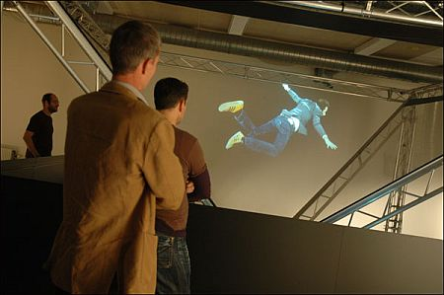
Current Status of 3D Display
Vizoo Cheoptics 360
“Danish company ViZoo developed the Cheoptics360, a 360 degree holographic video display system.” www.i4you.com

Slide 40
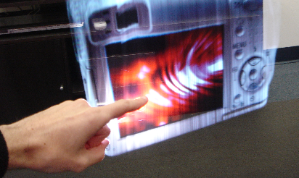
Current Status of 3D Display
IO2 Technology: M3 Heliodisplay
“The Heliodisplay is a free-space display developed by IO2 Technology. A projector is focused onto a layer of mist in mid-air, resulting in a two-dimensional display that appears to float. This is similar in principle to the cinematic technique of rear projection.” www.wikipedia.com

Slide 41
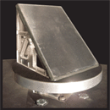

Current Status of 3D Display
Rotating mirror by the ICT Graphics Laboratory at the USC
Projecting high speed video onto a rapid rotating mirror, hence creating the illusion of a volumetric 3D image.
http://gl.ict.usc.edu/Research/3DDisplay/

Slide 42
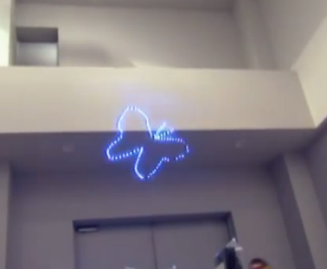
Current Status of 3D Display
3D via Laser Plasma Emission Technology
Using focused laser beam to produce plasma emission at a point. A scanning mirror steer the emission point in the 3D space

Slide 43

Current Status of 3D Display
3D mirage Technology

Slide 44

Current Status of 3D Display
3D floating image based on concave mirror

Slide 45
Current Status of 3D Display
Volumetric Display
Layered volumetic display based on persistence of vision (POV)
HoloBlade
LED cube
Mechanical pistons
Hanging strings

Slide 46
Current Status of 3D Display
Virtual Reality (VR) and Augmented Reality (AR)
VR: Presenting synthetic (usually computer generated) visual image to the eye
AR: Superimpose synthetic visual image to a physical scene
Hybrid AR/VR: Same as VR, but the background image is derived from a physical scene

Slide 47
Current Status of 3D Display
Typical Virtual Reality (VR) system
VR: Presenting synthetic (usually computer generated) visual image to the eye
Example: Oculus Rift
3D perception by showing left and right images on the corresponding micro-displays
Micro-display
Video images
Focusing lens

Slide 48
Current Status of 3D Display
Low Cost Virtual Reality (VR)
VR: Presenting synthetic (usually computer generated) visual image to the eye
Examples:
Samsung gear
Google Cardboard
Mobile phone
Content example:
X3DOM
Focusing lens

Slide 49
Current Status of 3D Display
Augmented Reality (AR)
AR: Superimpose synthetic visual image to a physical scene
Projector
Transparent
glass
Example:
Google glass (single channel)
Metavision (Stereoscopic)
Microsoft Holo-lens (Stereoscopic)
Prism

Slide 50
Current Status of 3D Display
Virtual/Augmented Reality
Camera captures the physical scene, and present the image to the eyes together with synthetic contents
Camera
Example:
Augmented Apps
Mobile phone
Focusing lens

Slide 51
Current Status of 3D Display
Virtual Reality with X3DOM (www.x3dom.org)
A simple and friendly web based platform for displaying 3D computer graphics (CG) models.
Generate the standard html web template below.
Embedded the codes on 3D model.
View the result on a standard browser (e.g. Firefox).
Observe the 3D model from different viewing angle with the pointing devices (e.g. mouse).
<html>
<head>
<title>My first X3DOM page</title>
<script type='text/javascript' src='http://www.x3dom.org/download/x3dom.js'> </script>
<link rel='stylesheet' type='text/css' href='http://www.x3dom.org/download/x3dom.css'></link>
</head>
<body>
<h1>Hello, X3DOM!</h1>
<p>
This is my first html page with some 3d objects.
</p>
</body>
</html>

Slide 52


Current Status of 3D Display
Virtual Reality with X3DOM (www.x3dom.org)
Generate the standard html web template below.
Embedded the codes on 3D model.
View the result on a standard browser (e.g. Firefox).
Observe the 3D model from different viewing angle with the pointing devices (e.g. mouse).
<x3d width=‘100px' height=‘100px'>
<scene>
<shape>
<appearance>
<material diffuseColor='1 0 0'></material>
</appearance>
<box></box>
</scene>
</x3d>
Rotate with mouse

Slide 53
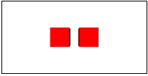
Current Status of 3D Display
Virtual Reality with X3DOM (www.x3dom.org)
Generate 2 views of the same model.
Place one on the left, and the other on the right.
Display the result on a standard browser (e.g. Firefox).
Observe the image pair with the VR headset
<x3d width=‘100px' height=‘100px'>
<scene>
<transform translation='-1.5 0 0'>
<shape>
<appearance>
<material diffuseColor='1 0 0'></material>
</appearance>
<box></box>
</shape></transform>
<transform translation='1.5 0 0'>
<shape>
<appearance>
<material diffuseColor='1 0 0'></material>
</appearance>
<box></box>
</shape></transform>
</scene>>
</x3d>
Lots of examples, including VR, are available in the website. Please learn how to build simple VR models for the headset.

Slide 54
Current Status of Desktop 3D Display
Lens Free Multiple Views Stereoscopic 3D Monitor
Monitor Reconstructs multiple views before spectators.
Screen
Typical number of views: 3 to 9.
Lenticular lens array
or barrier
V₁
V₂
V₃
V₄
V₅
V₆
V₇
L
R

Slide 55
Current Status of Desktop 3D Display
Lens Free Multiple Views Stereoscopic 3D Monitor
Monitor Reconstructs multiple views before spectators.
v7
v6
v5
v4
v3
v2
v1
Screen
Lenticular lens array
or barrier
V₁
V₂
V₃
V₄
V₅
V₆
V₇

Slide 56
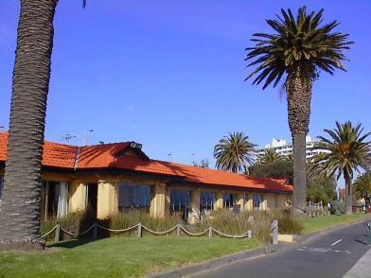
Image Acquisition and processing
Multiple cameras are required to capture and store the scene.
Major issues to consider
1. How to store?
2. How to compress?
3. Compatibility problem.
4. Storage media.
5. Broadcast media
6. Real Time 3D Display

Slide 57
Typical approach adopted to date
1. Digitize and store multi-view images into a computer.
2. Create virtual 3D scenes with graphical software (e.g. 3DMAX)
3D File
Renderer
Issues to consider
1. A computer is needed
2. Tedious process
3D Monitor
3. Fast Processor required
4. Higher Cost
5. Bulky setup
V₁
V₂
V₃
V₄
V₅
V₆
V₇

Slide 58
Typical approach adopted to date
1. 2D + Depth: Capture intensity and depth of each picture frame
2. Generate multi-view images.
2D+Depth
Renderer
Issues to consider
1. 3D camera is needed
2. Tedious process
3D Monitor
3. Fast Processor required
4. Higher Cost
V₁
V₂
V₃
V₄
V₅
V₆
V₇

Slide 59
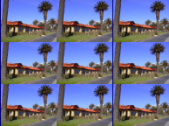
A simplified framework: Static N-tile format
Multiplexer
Single
N-tile image
Process like an ordinary
2D picture

Slide 60
A simplified framework: Static N-tile format
Modulator
PAL signal
Broadcast via existing TV channels
Store in Bluray, DVD, VCD, VCR, etc.
Compress with MPEG, JPEG2000, etc.

Slide 61
A simplified framework: Static N-tile format
Renderer
3D Monitor
V₁
V₂
V₃
V₄
V₅
V₆
V₇

Slide 62
Problems of the simplified framework
1. Poor resolution: each view is downsampled
2. Degradation in 3D perception
3. Lack of hardware and software solutions for real time operations
Simply speaking, there are lots of problems remain unsolved.

Slide 63
Nevertheless, the N-tile format is a viable solution
Video Capturing
DTT
3D Decoder
DVD
VCD
NTSC
Multi-views generation
Visual Quality Enhancement
VCR
MPEG
PAL
Integration
Display
Blu-ray
3D video acquisition and Production
Existing Video Chains
3D Display
Integration of 3D video in existing video chains

Slide 64
Potential of 3D Display System
The 3D display system will create a significant impact on the traditional channel of conveying video and graphic contents. Our technology will enable 3D contents to be produced and display at a very competitive cost based on existing video equipment and video chains.
For example, potential applications of 3D Kiosks
1. Advertising companies
2. Tourism companies
3. Conference and exhibitions organizers
4. The entertainment industries

Slide 65
The Future
Lets see from the video clip what is anticipated in the future

Slide 66
Photography vs Holography
Photography: Recording and reproduction of a single 2D perspective of a 3D scene on a 2D media (such as film).
Opaque
Pin-hole
Photo-film
Photo-film
The pin-hole only allows light waves from a single view of the scene to go through. The rest are blocked. The light beam from each point on the scene hits on a unique spot on the photo-film, and its intensity is recorded on the photo-emulsion at that particular point.

Slide 67
Photography vs Holography
Apparently, removing the pin-hole will allow all the light wave from different views of the scene to get through.
Photo-film
But then the light wave from all viewing directions will be accumulated on the photo-film through scalar addition. Once added, light wave from individual viewing direction cannot be separate in the future. The image on the photo-film is a chaotic pattern that bears no resemblance to the original scene.

Slide 68
Holography
Hologram: Same principle, but the complex optical waves are added up
Photo-film
(Hologram)
The holographic signal H(x,y) is complex (with magnitude and phase when a light beam arrive at a point on the photo-film.

Slide 69
Holography
Hologram
When the actual object is removed, H(x,y) reproduced all the recorded light waves, and the observer will have the illusion of seeing the original object image.
However, photo-film can only record the magnitude (i.e. intensity) of the light wave.

Slide 70
Optical Holography
Hologram: Recording and reproduction of 3D scene on and from a 2D media (such as film).
Laser
Laser
Hologram
Hologram

Slide 71
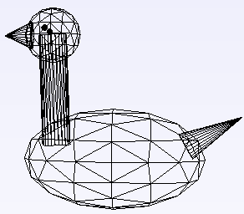
Computer Generated Holography
Computer Generated Hologram (CGH): Generation of holograms numerically from three dimensional (3-D) models that do not actually exist in the real world.
Computer
Hologram file
Printer/Display
hologram
3D Computer graphic model
Given a discrete, 3-D image, a digital hologram can be generated numerically as the real part of the product of the object and a planar reference waves. The 3-D image can be reconstructed from the hologram afterwards.

Slide 72
Computer Generated Holography
3D Object
Space
Hologram
x
z
Object
y
point
1. Compute the diffracted wave from each individual point.
2. Sum up the contributions of all the points to form the hologram

Slide 73
Computer Generated Holography
3D Object
Space
u
Hologram
x
z
Object
v
y
point
A single point

Slide 74
Computer Generated Holography
3D Object
Space
u
Hologram
x
z
Object
v
y
point
All the points

Slide 75
Problems with Digital Holography
A digital Hologram is complex and cannot be printed on a photo-film.
Existing display devices (SLM) can only display either magnitude or phase component
Generating a hologram involves very heavy amount of computation.

Slide 76
Other problems with Digital Holography
1. This walkthrough only provides a brief glimpse on the 3D technology
2. There are plenty of details.
3. Past, present, and emerging technologies can work in synergy.

