Slide 1

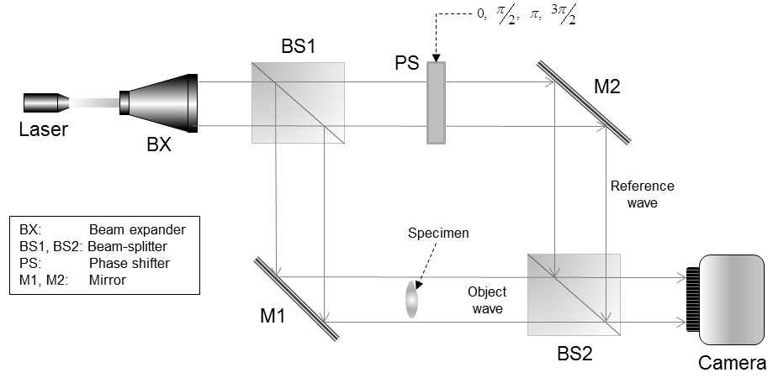
Capturing hologram of physical objects
Reference and object waves are summed up in camera
Optical setup of Hologram capturing system
(Camera can only capture real image)

Slide 2
Capturing hologram of physical objects
Plane wave: phase shift is identical for the entire plane. However the phase shift varies with different position.
sideview
Hologram plane
θ₂
θ₀
θ₁
θ₂
θ₀
On-axis (inline) hologram: A hologram that is illuminated by a plane wave that is parallel to it.

Slide 3
Capturing hologram of physical objects
Off-axis plane wave: phase shift is identical for the entire plane. However the phase shift varies with different position.
sideview
θ₀
θ
α
y
Vertically, phase shift
θ = θ₀ + ysinα
phase shift is identical horizontally

Slide 4
Capturing hologram of physical objects
Off-axis hologram: Reconstructed image and twin image are separated by angle α. However, the 2 images will overlapped when is small or zero (inline hologram)
Laser
The value of α is limited by the pixel size, only about 1.5 degree with pixel size = 10um. Current SLM size is between 3.4 to 18 micron, so α is pretty small.
Camera or photofilm
which only records intensity
α
Reconstructed
image
Plane Wave
α
DC
Defocused
twin
image
Display
H(u,v)

Slide 5
Capturing hologram of physical objects
Inline or on-axis hologram: does not rely on the angle of the illumination beam, but need to suppress the twin image. But is that possible?
Laser
Consider a plane wave that is parallel to the hologram, and having a constant phase shift π on every point on the hologram plane.

Slide 6
Capturing hologram of physical objects:
Interferogram
What happen when 2 complex-valued pixel A (from object wave) and B (from reference wave) are summed up in the camera?
The intensity detected by the camera is equal to G, which can be expressed as
Mixing object wave and reference wave
Note that the imaginary component is lost. PSH captures a complex-values hologram by mixing the object wave (i.e. pixel A) with 4 reference waves, each with a different phase angle. This results in 4 interferograms.
A plane wave has identical phase all over the entire plane, and the 4 phases added to the reference wave are 0, π/2, π, and 3π/2.

Slide 7
Capturing hologram of physical objects
A plane wave has identical phase all over the entire plane, we assume that the 4 phases to be 0, π/2, π, and 3π/2. Assuming the magnitude of B (reference) is unity and considerably larger than the magnitude of A, and dropping the latter as it is just a DC term, we have

Slide 8
Capturing hologram of physical objects
Apart from the phase shift of the reference plane wave, which does not affect the hologram, the complex-valued object wave is recovered

Slide 9
Capturing hologram of physical objects
Extending it to the entire hologram by applying the same equations to all the pixels, and without loss of generality assuming θ=0, the object wave of the specimen is fully recovered.

Slide 10
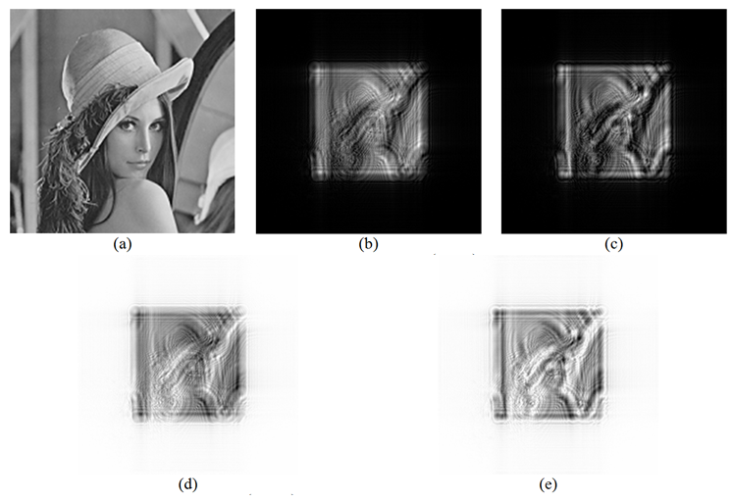

Capturing hologram of physical objects

Slide 11
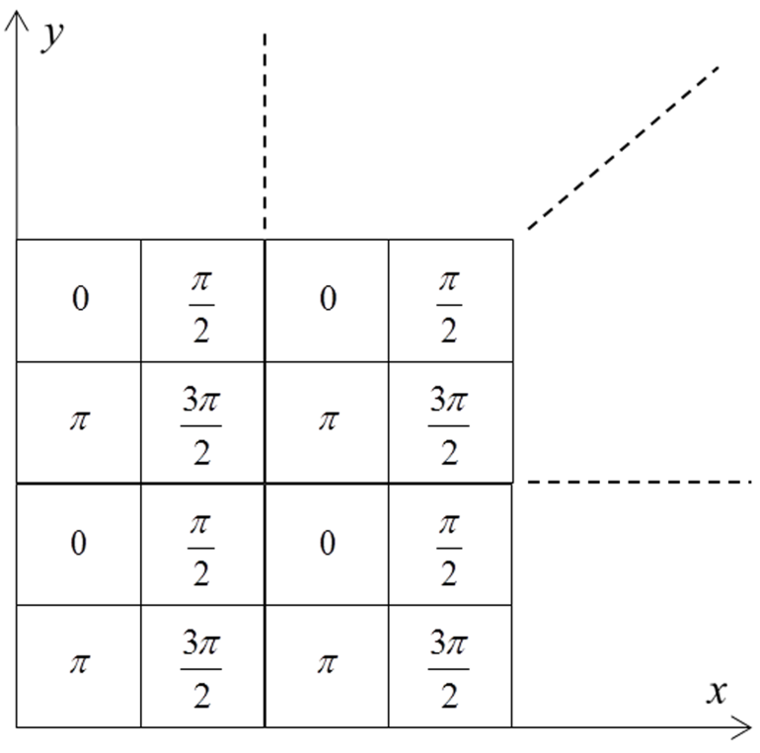
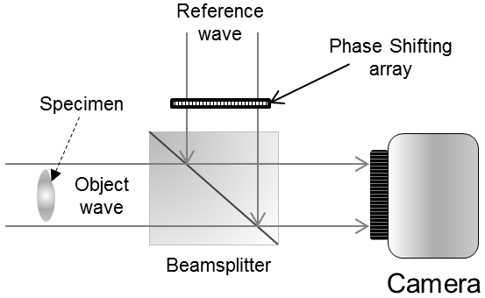
Capturing hologram of physical objects
However, a 4 steps PSH require taking 4 images, hence cannot be applied to moving scenes. To overcome this problem, a checkerboard phase retarder array is employed.
Mixing object wave and reference wave
The four phases are spatially mutliplexed so that each pixel is obtained from the mixing of the object wave and the corresponding phase shifted reference plane wave at that point.
It can be envisaged that the four phase-shifted images are now combined into one image.

Slide 12
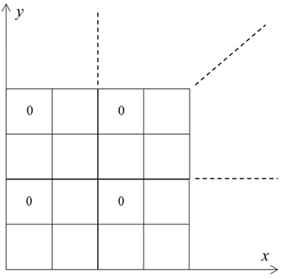
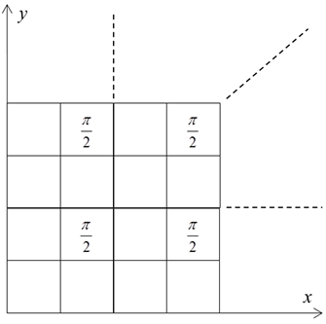
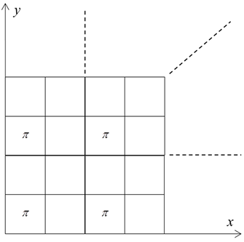
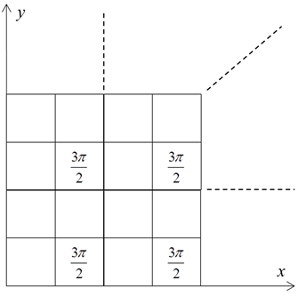
Capturing hologram of physical objects
In addition, each image is downsampled by 4 times, a bit similar to the integration of multiple view images in an autostereoscopic monitor.
Mixing object wave and reference wave
Some sort of interpolation is needed to fill in the missing gap
G₁
G₂
G₃
G₄

Slide 13
Optical Scanning Holography
PSH is based on recording interference patterns of object and reference waves with a digital camera.
Hence size and resolution of the hologram, and hence the scene, are limited by the camera.
Mixing object wave and reference wave
Optical scanning holography (OSH) is based on scanning the object, and constructing the hologram in a pixel by pixel manner. Hence not rigidly limited to size and resolution.
In an OSH system, the recording sensor is a single photodetector. As such it can be considered as a ‘single pixel hologram camera’.
The technology is invented by ‘Poon and Korpel’ in the late 70s. It can be used to capture holograms of both macroscopic and microscopic object.

Slide 14








Optical Scanning Holography
Specimen
Plane wave
$$ω_{0}+Ω$$
Spherical wave
Photo-detector
Band pass filter
Point source
$$ω_{0}$$
$$cosΩt$$
Specimen is scanned with the combined beams of a plane wave and a spherical wave in a zigzag manner
Cosine hologram
$$i_{c}$$
low pass filter
$$×$$
Sine hologram
$$i_{s}$$
low pass filter
$$×$$
$$sinΩt$$

Slide 15
Optical Scanning Holography
Combined beam
Specimen is scanned with the combined beams in a zigzag manner

Slide 16
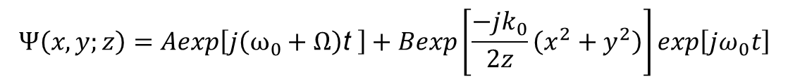
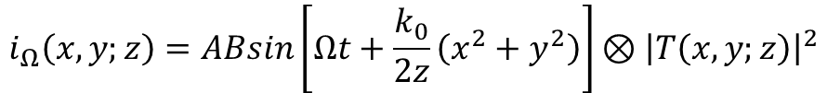
Optical Scanning Holography
Combined beam:
$$Ψ\left(x,y;z\right)=Aexp\left[j\left(ω_{0}+Ω\right)\text{t} \right]+Bexp\left[\frac{−jk_{0}}{2z}\left(x^{2}+y^{2}\right)\right]exp\left[jω_{0}t\right]$$
Plane wave
Spherical wave
When the specimen is illuminated with the combined beam, the signal picked up by the photodetector is
$$i\left(x,y;z\right)={\left|T\left(x,y;z\right)⊗Ψ\left(x,y;z\right)\right|}^{2}$$
After band-pass filtering tuned at the heterodyne frequency $Ω$, we have
$$i_{Ω}\left(x,y;z\right)=ABsin\left[Ωt+\frac{k_{0}}{2z}\left(x^{2}+y^{2}\right)\right]⊗{\left|T\left(x,y;z\right)\right|}^{2}$$

