Slide 1

3D for the public viewers
Binocular (perceivable with 2 eyes)
Left
Right
How to direct the left and right images to the correct eye?
Optical
Splitter
Left eye
Right eye

Slide 2
Anaglyph
Transmission
Blue filter
Red filter
475nm
475nm
650nm
Wavelength
Right picture
Red component only
Left picture
Blue component only
Projection
Blue filter
Red filter

Slide 3
Polarized glasses based Stereoscopic 3D
Usual approach: Display left and right eyes images on the same screen, and utilizes polarized glasses to direct each image to the corresponding eye.
Malus’s law: Intensity is attenuated by the square of the cosine of the angle between the polarization directions of the light and the polarizing filter, as
Hence, the viewing level must be strictly horizontal to avoid ghosting.
Right picture
polarized at 90 degree
Left picture
polarized at 0 degree
Projection
0 degree polarizer
90 degree polarizer

Slide 4
Circular Polarizing filter
Circular Polarizing filter: polarization rotates clockwise or anticlockwise after passing through it.
Anticlockwise polarizer
90º
0º
Unpolarized light
Polarizing angle
90º
0º
Unpolarized light
Clockwise polarizer
http://upload.wikimedia.org/wikipedia/commons/d/d1/Circular.Polarization.Circularly.Polarized.Light_Left.Hand.Animation.305x190.255Colors.gif

Slide 5
Circular Polarizing filter
Circular Polarizing filter: polarization rotates clockwise or anticlockwise after passing through it.
Anticlockwise polarizer
90º
0º
Unpolarized light
90º
Block
0º
Anticlockwise polarized light
Clockwise polarizer

Slide 6
Circular Polarized glasses
based Stereoscopic 3D
Using circular polarized images and glasses avoid the constraint on level viewing. Adopted in modern 3D movies and TV signals.
Right picture
Anticlockwise polarized
Left picture
Clockwise polarized
Projection
Clockwise polarizer
Anticlockwise polarizer

Slide 7
Stereoscopic 3D on TV
Time division multiplexing
Left and right images are shown in the odd and even ( or even and odd) frames, respectively.
Active shutter glass
L
R
L
R
L
R
Synchronized to respective field
Left image
Right image
Lower brightness as glasses are only conducted at 50% of time. Expensive and bulky active shutter glasses.

Slide 8

Stereoscopic 3D on TV
Film-type Patterned Retarder: LG
Checker sampling technology
Left eye picture (cw-cp)
Right eye picture (acw-cp)
A film with circular polarizing element is placed on each pixel. Left and right pixels have different direction of polarization (cw-cp and acw-cp).
No flickering, brighter image. Low cost glasses.
Clockwise circular polarizer
Anticlockwise circular polarizer
Picture resolution is lowered by a factor of 2.

Slide 9
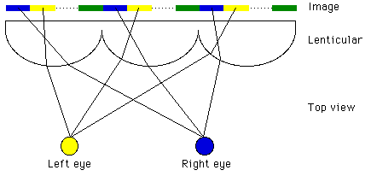
Glass free (naked eye) 3D viewing
Origin: Classic lenticular 3D photographs.
Basic concept: Interleave 2 or more views on the screen.
Overlay a lenticular lens array, or a parallax barrier.
The lens array or barrier deflects each view to its respective direction.
Interlaced image
Lenticular lens array
Left image pixel
Right image pixel
Left Eye
Right Eye
Interleaving and viewing of a pair of stereoscopic images

Slide 10
Glass free (naked eye) 3D viewing
Interleaving left and right images on the screen can be described as a decimation and interpolation process.
1. Each image is decimated into a new image that is half of its original width. 2. The decimated images are interpolated and interleave on the screen.
A
A
A
Blank strip filled by the second image
Decimation
Interpolation
Decimation leads to distortion which cannot be fully recovered with interpolation.
Decimation, interpolation, and Interleaving of a pair of stereoscopic images

Slide 11
Decimation
x(n)
M
y(n)
M is the decimation factor
x(n)
e.g. M = 2
x’(n)
-4
-3
-2
-1
0
1
2
3
4
-4
-3
-2
-1
0
1
2
3
4
y(n)
Something is lost!

Slide 12
Decimation in 2 steps: 1st step
x(n)
x’(n)
x(n) n = 0 , +M , +2M , +3M , +4M, ...
x’(n) =
0 otherwise
(1)

Slide 13
Decimation: 1st step
(1)
i(n)
-2M
-M
0
M
2M
i(n) is a periodic impulse train that can be expressed as
(2)

Slide 14
Decimation: 1st step
(1)
(2)
(3)

Slide 15
Decimation: 2nd step
x(n)
x’(n)
y(n)
y(n) = x’(Mn)
(4)
According to equation (3)
(5)

Slide 16
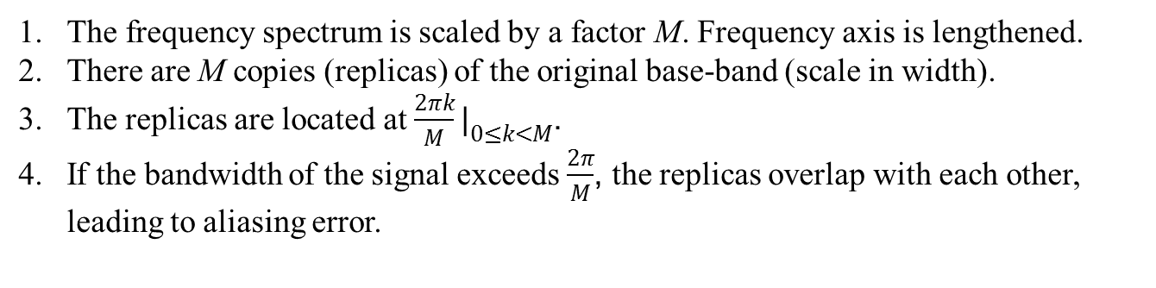
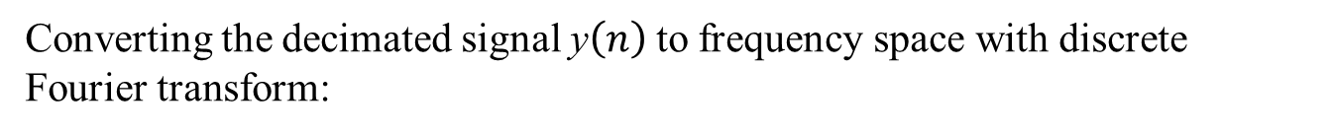
Decimation: 2nd step
The frequency spectrum of x$\left(n\right)$ is $X\left(e^{jω}\right)$.
Converting the decimated signal y$\left(n\right)$to frequency space with discrete Fourier transform:
The frequency spectrum is scaled by a factor M. Frequency axis is lengthened.
There are M copies (replicas) of the original base-band (scale in width).
The replicas are located at $\frac{2πk}{M}|_{0≤k<M}$.
If the bandwidth of the signal exceeds $\frac{2π}{M}$, the replicas overlap with each other, leading to aliasing error.

Slide 17

Decimation: illustration
x(n)
x’(n)
y(n)
−π/4
0
π/4
π/2
3π/4
π
5π/4
3π/2
7π/4
2π
π/4
π/2
3π/4
π
M=4
−π/4
0
π/4
π/2
3π/4
π
5π/4
3π/2
7π/4
2π
π/4
π/2
3π/4
π
−π/4
0
π/4
π/2
3π/4
π
5π/4
3π/2
7π/4
2π
π/4
π/2
3π/4
π

Slide 18
Interpolation
x(n)
M
y(n)
e.g. M = 2
x(n)
y(n)
-2
-1
0
1
2
-4
-3
-2
-1
0
1
2
3
4

Slide 19

Interpolation
x(n)
M
y(n)
x(n/M) n = 0 , +M , +2M , +3M , ...
y(n) =
(6)
0 otherwise
$$Y\left(e^{jω}\right)=X\left(e^{jωM}\right)$$
The frequency spectrum is scaled by a factor M. The frequency scale is compressed.

Slide 20
Interpolation
−π/4
0
π/4
π/2
3π/4
π
5π/4
3π/2
7π/4
2π
π/4
π/2
3π/4
π
M=4
−π/4
0
π/4
π/2
3π/4
π
5π/4
3π/2
7π/4
2π
π/4
π/2
3π/4
π
No change other than a scaling of the frequency axis.

Slide 21
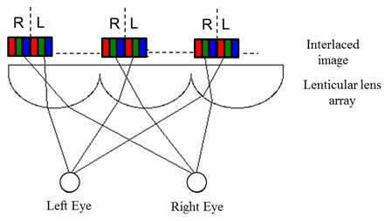
Glass free (naked eye) 3D viewing
Does it works on monitor?
A pixel on the screen
Intuitively, we can simply interleave the pixels on the monitor in alternating left and right manner.

Slide 22
Glass free (naked eye) 3D viewing
Early product by Sharp: Stereoscopic (2 views) with rainbow moiré pattern
Left pixel
Right pixel
Usual pixel arrangement
Interleaving and viewing multi-view images
Slight difference in viewing positions capture incomplete pixel components

Slide 23
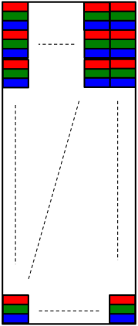
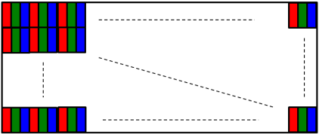
Glass free (naked eye) 3D viewing
Avoiding rainbow moiré patterns: Rotate screen by 90 degree.
Left pixel
Right pixel
Rotated pixel arrangement
Interlaced images
Lenticular lens array
Slight difference in viewing positions capture same pixel components. Very poor resolution for large number of views.
Left Eye
Right Eye
Interleaving and viewing multi-view images

Slide 24
Glass free (naked eye) 3D viewing
with Auto-stereoscopic monitor
1
2
3
4
5
6
7
1
2
3
4
5
6
7
1
2
3
4
5
6
7
1
2
3
4
5
6
7
1
2
3
4
5
6
7
1
2
3
4
5
6
7
1
2
3
4
5
6
7
1
2
3
4
5
6
7
Lenticular lens array
Magnified view of one lens column
Very poor horizontal resolution

Slide 25

Glass free (naked eye) 3D viewing
with Auto-stereoscopic monitor
Rotating the lenticular lens array by certain degree

Slide 26
Glass free 3D viewing
Slant Lenticular technology
Philips patent: US6,064,424 (May 2000)
Distribute resolution degradation to horizontal and vertical directions
View 2
View 3
View 4
6
2
4
6
2
4
6
2
4
6
2
4
6
2
4
6
2
4
6
2
4
6
2
4
6
2
4
5
1
3
5
1
3
5
1
3
5
1
3
5
1
3
5
1
3
5
1
3
5
1
3
5
1
3
6
4
6
2
4
6
2
6
4
6
2
4
6
2
4
6
2
4
6
2
4
6
2
4
2
2
2
4
2
2
3
5
1
3
5
1
3
5
1
3
5
1
3
5
1
3
5
1
3
5
1
3
5
1
3
5
1
2
4
6
2
4
6
2
4
6
2
4
6
2
4
6
2
4
6
2
4
6
2
4
6
2
4
6

Slide 27
Packaging and distribution of muti-view signals
An early attempt to compress 3D stereoscopic sequences has been made by the MPEG with the incorporation of the Multiview Profile (MVP) [1][2] into the existing MPEG II standard. The approach is largely an extension of the temporal scalability, but so far the MVP has not been adopted as a commercially available service.
[1] M. Tanimoto and T. Fuji, “Utilization of inter-view correlation for multiple view video coding”, ISO/IEC JTC1/SC29/WG11 M11014, July 2004.
[2] H. Wang, et al, “Using inter-view prediction for multi-view video compression”, ISO/IEC JTC1/SC29/WG11 M10512, Mar. 2004.

Slide 28
Packaging and distribution of muti-view signals
Another approach has been developed by the Mitsubishi Electrical Research Laboratory. Its technology, known as the “simulcast” compresses individual views of video sequences with MPEG II and dispatches them via separate channel.
At the receiver they were decoded and integrated and shown on the 3D display. The method is straightforward, compatible with existing Digital Broadcasting infrastructure.
However the system is extremely complicated, requiring multiple PCs and high bandwidth networks on both the transmission and receiving sides.

Slide 29
Packaging and distribution of muti-view signals
The “Advanced Three-dimensional Television System Technologies (ATTEST) project [3] of the European Information Society Technologies (IST) aims at the development of a complete 3D-video chain including content creation, coding, transmission and display.
“Depth Image Based Rendering” (DIBR) technology is adopted where a Three Dimensional Scene is encoded as a single view plus a depth map.
To allow backward compatibility to existing 2D digital television, the base layer is encoded with MPEG II and DVB standards. The depth map is transmitted in the enhancement layer with MPEG 2/4/7 standard providing a depth value for each pixel in the base layer. At the receiver, 3D views are generated from the 2D image of the base layer and the depth map of the enhancement layer.
[3] M.O. Beeck, “Towards an Optimized 3D Broadcast Chain”, Proc. SPIE 4864, Three-Dimensional TV, Video, and Display, 42 (November 1, 2002);

Slide 30
Packaging and distribution of muti-view signals
it is unlikely that the compressed multi-view 3D data could be distributed directly in the same way as the existing channels and standards.
While it may be argued that technically, present standards and hardware solutions could always be changed to accommodate the newer technologies, such revolutions usually have to experience long period of incubation period before every components in the video chain could function collaboratively and survive in the consumer’s world.
StereoGraphics offers an alternative approach know as the “N-tiles”, a.k.a. the Hollywood Squares” format.
Images from cameras each capturing a view of the scene are down-sampled and juxtaposed as non-overlapped tiles into a single picture.
This enables multi-view images cav be processed in the same way as ordinary two dimensional pictures, and embedded into existing video chains.

Slide 31
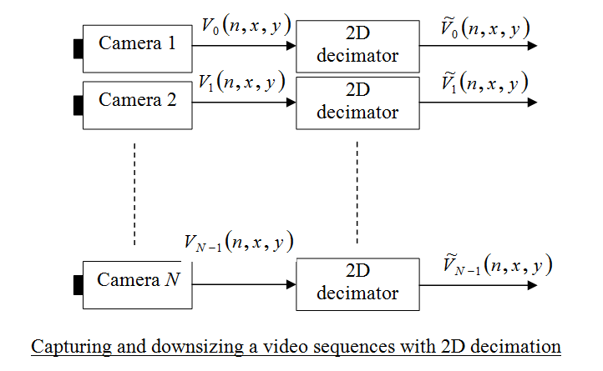
Packaging and distribution of muti-view signals: N-tile format

Slide 32
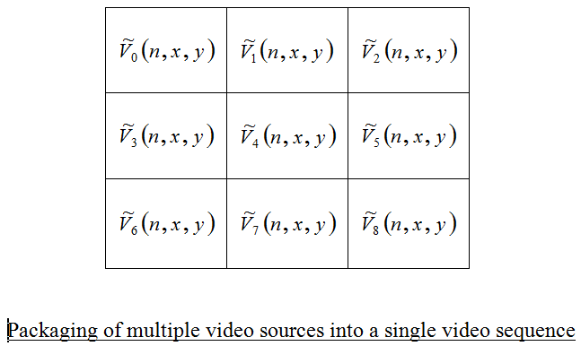
Packaging and distribution of muti-view signals: N-tile format

Slide 33
Packaging and distribution of muti-view signals: N-tile format
In general, though not mandatory, the number of cameras N is taken to be the square of an integer D, i.e.
W(n,x,y) is just an ordinary picture frame that can be modulated, compressed, broadcast and recorded by any existing standards.
At the receiving end, each view in W(n,x,y) is mapped to the corresponding sub-pixel in the auto-stereoscopic 3D monitor.

Slide 34
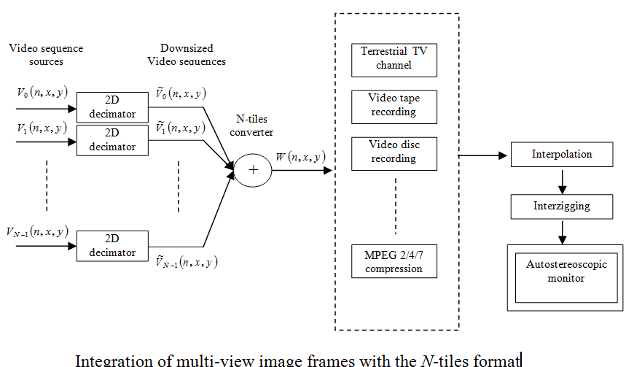
Packaging and distribution of muti-view signals: N-tile format

